Slide 1

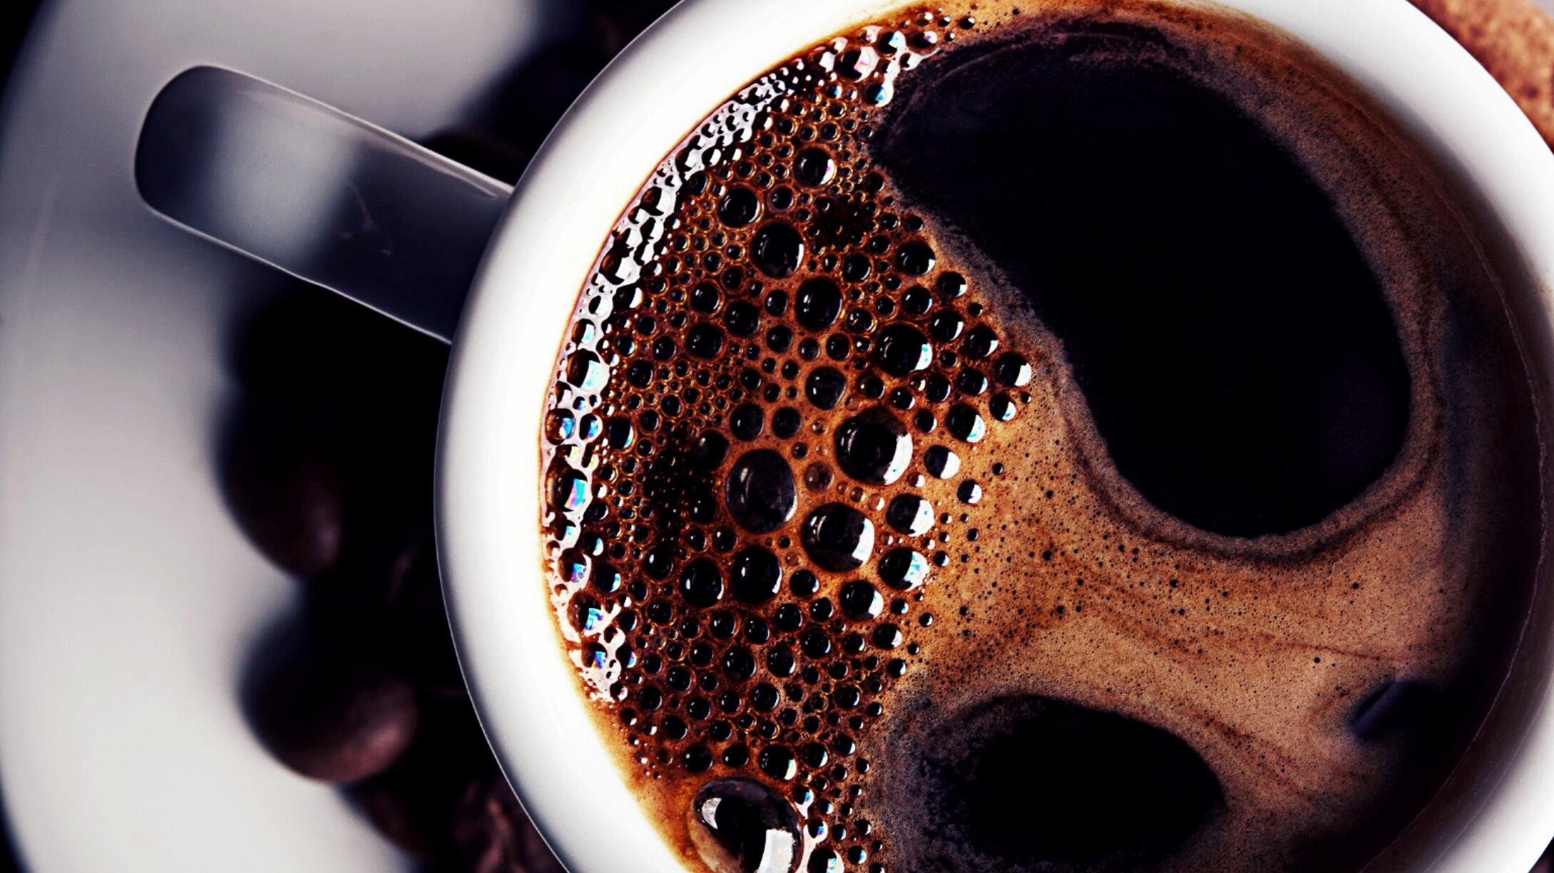
IST 718: Project Coffee Bean Analysis
Tim Cordero

Slide 2

Specification
Coffee Bean Data collected from the Coffee Quality Institute
1,339 observations
4 csv files
Determine what features make a high-quality coffee bean
Predict quality score for coffee bean input

Slide 3
Scrub
Same columns named differently in respective files
Drop rows with no corresponding record for ratings
Set Indexes
Dropping duplicated columns once Data Frames were merged
1,311 observations for Arabica beans and only 28 for Robusta

Slide 4
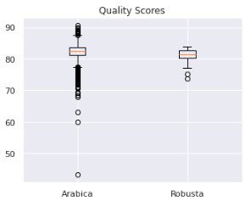
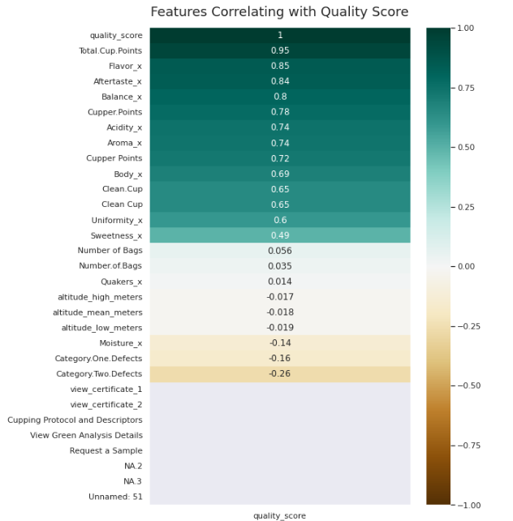
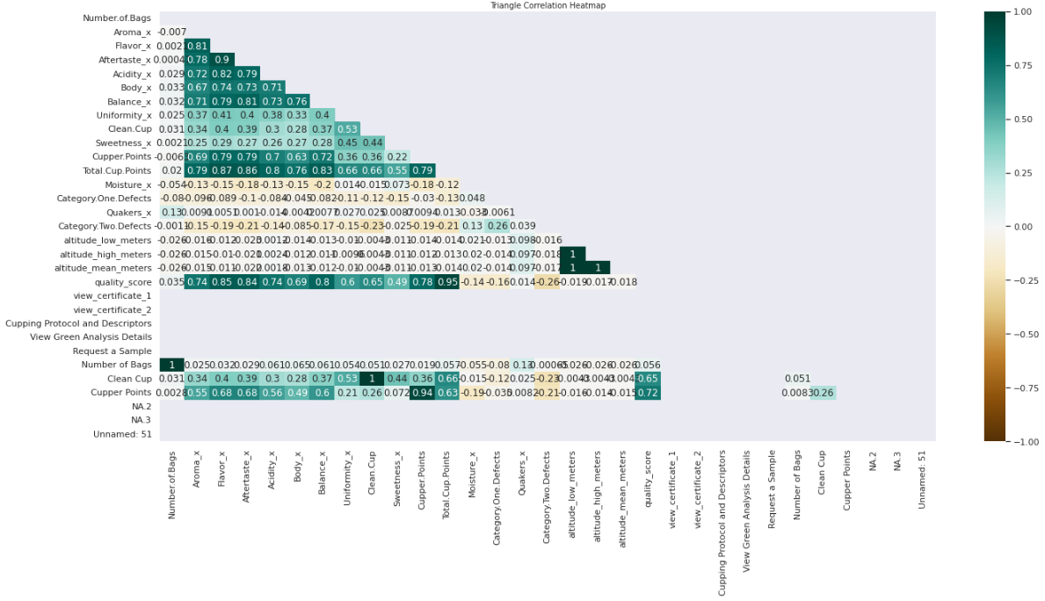
Observation

Slide 5
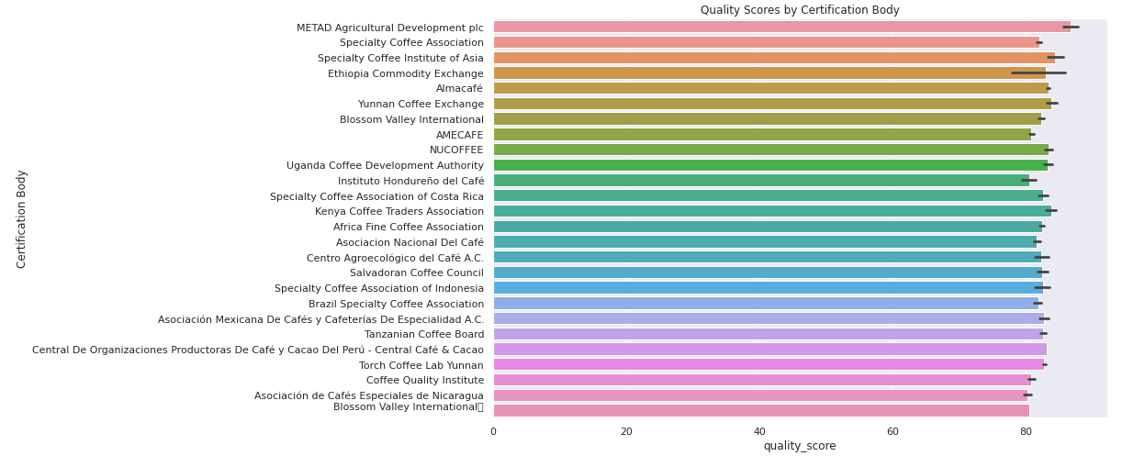
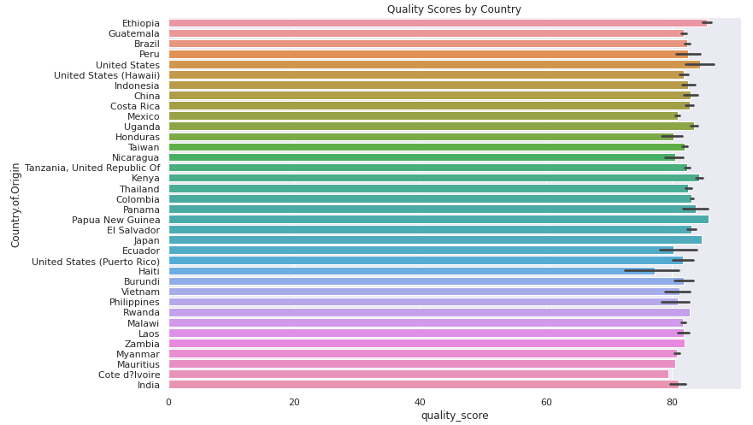
Observation (Cont.)

Slide 6
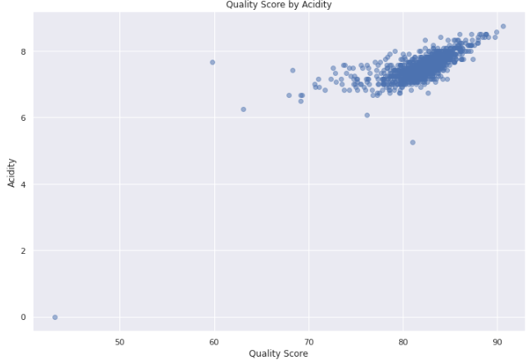
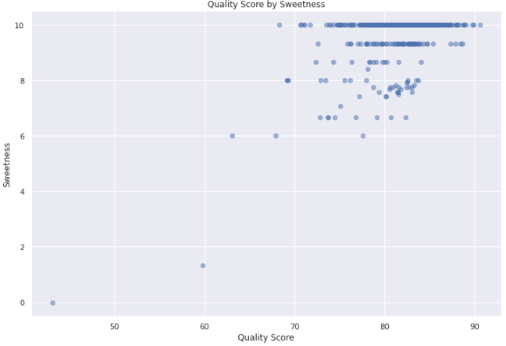
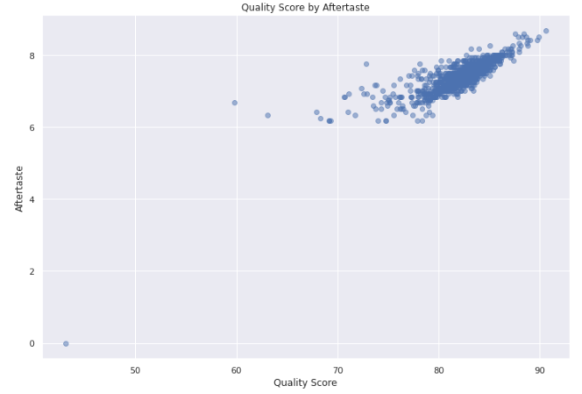
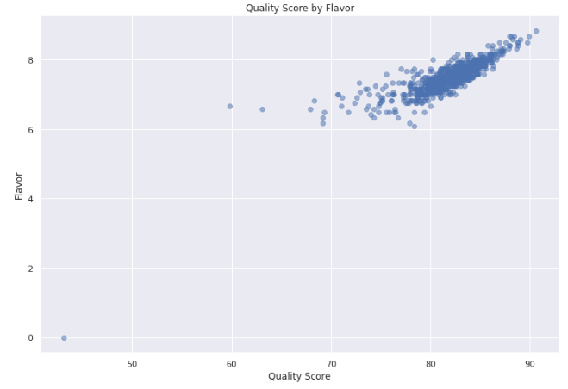
Observation (Cont.)

Slide 7
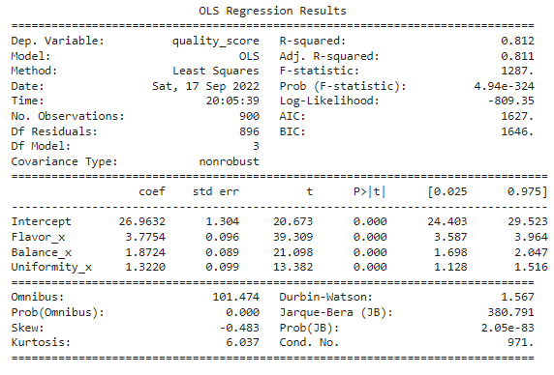
Analysis
Ordinary Least Squares model accounts for 81% variability in the data
- Predicting quality score by Flavor, Balance, and Uniformity

Slide 8
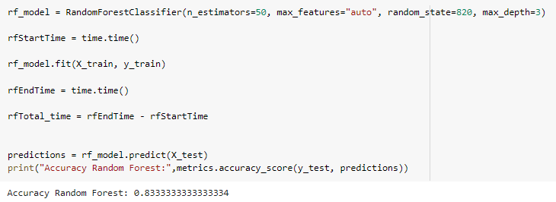
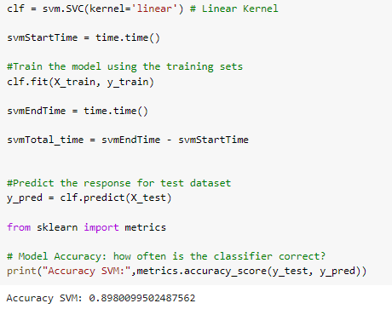
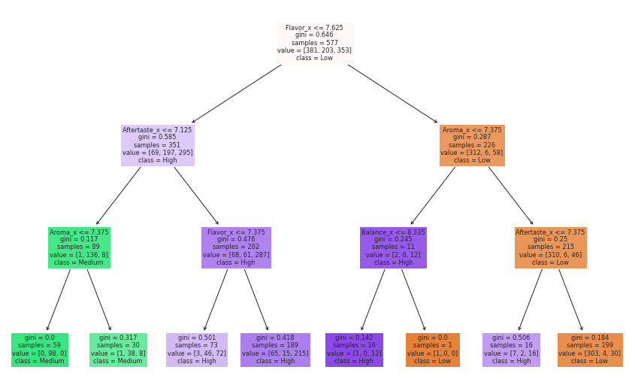
Analysis (Cont.)

Slide 9
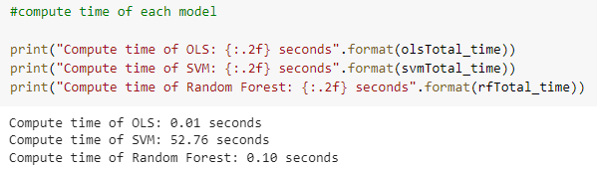
Analysis (Cont.)
SVM Model had the best accuracy at 89%
Orderly Least Squares Model had the best compute time at 0.01 seconds
Seems as though Flavor and Aftertaste scores are the best indicators toward a quality coffee beam
Planning on using the SVM model to predict quality of user coffee bean

Slide 10
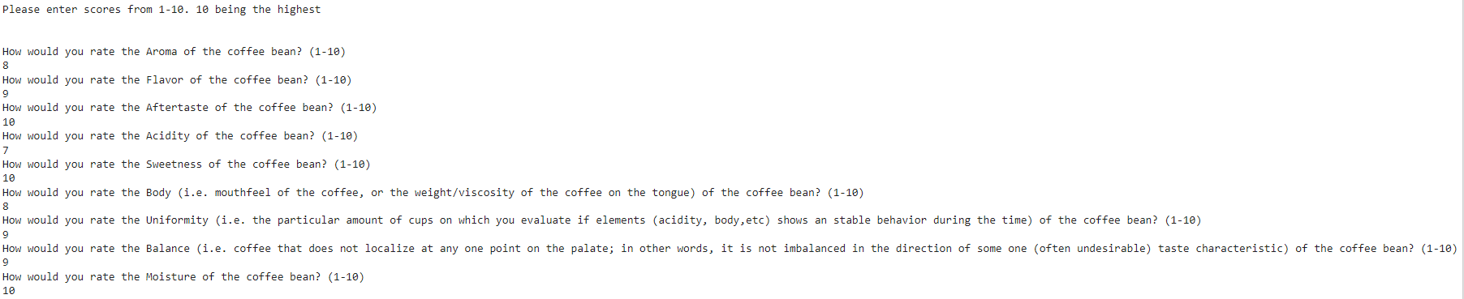
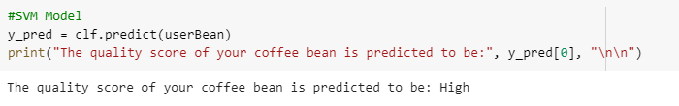
Recommendation

Slide 11
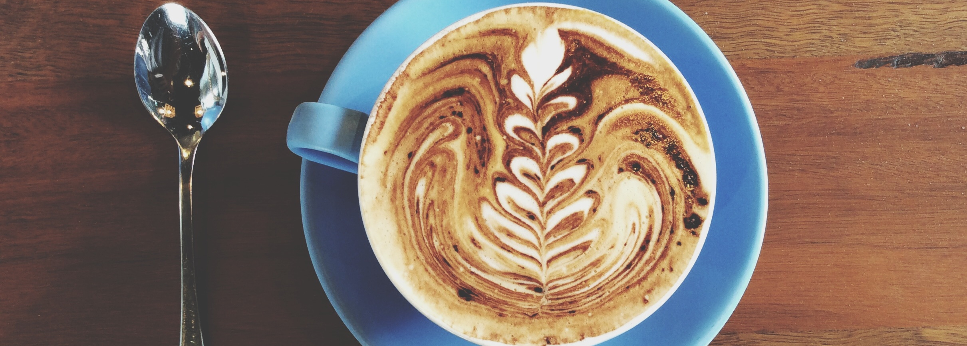
Thank You!
https://pandas.pydata.org/
https://scikit-learn.org/stable/
https://medium.com/@szabo.bibor/how-to-create-a-seaborn-correlation-heatmap-in-python-834c0686b88e

